Slide 1
Poverty
What meaning does it have for India?
Dr. Santosh Kumar Meher
Reader in Economics
Email. santoshmeher.eco@yahoo.com

Slide 2
Poverty
What meaning does it have for India?
Introduction
Objectives
Meaning of Poverty
Parameters through which poverty of a country can be analysed
An Economic Analysis
Characteristics of a Indian Economy
India is Poor
Recent Approaches to fight poverty in India
Suggestions
Conclusion

Slide 3
Introduction
Poverty is a global problem
Sustainable Development Goals (SDGs) have set ‘Poverty’ as the first of 17 goals. The broad target is to ‘End poverty in all forms everywhere’.
Any discourse on poverty is like a drop of water in the vast ocean of poverty literature.
This urges us to understand what poverty really means and what its different forms are (i.e. how is it manifested or what are its various dimensions) and where it is present.
Thus there are three issues:
  What?
  How?
  Where?

Slide 4
Objectives
To define poverty
To examine the various dimensions of poverty in Indian context

Slide 5
  Meaning of Poverty
  Poverty is understood in terms of its two meanings: Absolute Poverty & Relative Poverty
  Absolute Poverty
  Absolute poverty refers to a situation whereby a household or individual is unable to manage his basic necessities. Traditionally, this is defined in terms of daily consumption basket required for a minimum living (Basically, ‘material deprivation’). This is called ‘Poverty Line’. Poverty line is defined on the basis of
  Daily basis: Minimum calorie requirement for an individual. Calorie requirement is defined in terms of the energy that a person gets from the food he or she eats per day
  Monthly basis: On the basis of the minimum consumption expenditure needed to survive or to manage minimum standard of living.
  Head Count Ratio measure of poverty: No. of people below poverty line divided by the total population

Slide 6
  The erstwhile Planning Commission of India defines poverty line in terms of minimum calorie intake of food necessary for existence. Poverty line calculated on daily basis: individual requirement of 2300 calories per day in rural areas and 2100 calories per day in urban areas (Planning Commission). The calorie norms in measuring poverty was introduced by Lord Boyd Orr, the first Director General of World Food and Agricultural Organization (2300 calories on average).
  Monthly Basis: Various agencies both at national, regional and global levels have defined poverty line in various ways.
  The Working Group of Indian Economists comprising Prof. D. R. Gadgil, Dr. B.N. Ganguli, Dr. P.S.Lokanathan defined poverty line for the first time in 19*2 (a minimum consumption expenditure of Rs.20 per capita per month and Rs.25 per capita per month for rural and urban areas respectively, based on 19*1-*2 prices. This practice is still retained in India and poverty line is defined in terms of consumption expenditure calculated by NSSO on the basis of its survey to estimate poverty conducted once in every 5 years.
  Tendulkar Committee defines Poverty Line in terms of the minimum earnings for a household
  (Per capita monthly earnings of INR 816 in rural areas and INR 1000 in urban areas in 2011-12 : poverty line was drawn by NSSO (68th Survey) on the basis of monthly consumption expenditure.
  (2011-12): 21.9 per cent of population in India living below poverty line.
  United Nations defines Poverty Line as US$1.25 a day in India and for all countries on an average it is US$1.90 a day. As per this estimate 32.7 per cent Indians are below poverty line (2011)

Slide 7
Poverty Trends in India
Year | Absolute number of poor (Crore) | HCR
19*1-*2 | 17 | 34
1979-80 | 33 | 48
1987-88 | 31 | 39.3
1993-94 | 32 | 3*
1999-2000 | 2* | 2*
2004-05 | 40 | 37.2
2009-10 | 35 | 29.8
2010-11 | 27 | 21.9
201*-17 | 12 | 29.8
Source: Economic Survey 201*-17 and World Bank Data

Slide 8
  Relative Poverty
  It is expressed in terms of inequality in income. Accordingly, it classifies two classes: (Rich and Poor – For Karl Marx, they are ‘Haves’ and ‘Have-nots’)
  Poverty, in both forms, is not unique to the present day society. In fact it existed earlier in every society.

Slide 9
  For example: Marx interpreted History of development a Society in terms of Class Struggle – That is the struggle for existence by the deprived sections. Marx was anxious of what future would look like. That means on the basis of the contemporary developments in Capitalism he wanted to predict the next stage of development. In order to explain the future of capitalism (which has its own inconsistencies and contradictions) and to support his explanation with a logic, he wanted to know what had happened in the history of the society. He went through the pages of History and came to the conclusion that in every society in the past there were contradictions within it and those contradictions were linked to the ownership of material assets. This accentuates inequality further.

Slide 10
New Conceptions of Poverty (emerging)
Poverty is a multi-dimensional social phenomenon (Robert Chambers 2000)
While the approach of the study on poverty mostly takes the form of its estimate in terms of income and consumption, i.e. income poverty, welfare criterion emphasizes upon several aspects of wellbeing of the people (See for example Lister 2004; Spiker 2007)
Capabilities and functionings (Sen)
Freedom (Sen)
Sen in his book ‘On economic Inequality’ proprounded Sen’s Index to measure poverty. He rejects the concept of poverty line as an appropriate measure of poverty. He constructs poverty index on the basis of inequality of income of the people below poverty line.
Sen was against the traditional concept of dearth of supply of foodgrains due to fall in production as the cause of Bengal famine in the seventies. Rather, it is due to faulty system of distribution of foods. Suggests revamping PDS.
New Institutional Economics perspective: poverty can be assessed in terms of this perspective
Poverty can be defined in terms of the basic requirements for leading a minimum living in the environment one is in.
Living wage vrs. Minimum wage

Slide 11
Poverty Parameters in a brief
Poor livelihood (Absence of Sustainable Livelihood)
(Hunger index, malnutrition, absence of caring, access denial)
Gender issues (Disparity)
Vulnerabilities upon the vulnerable groups (extent of vulnerability is context-specific)
- Exploitation of Women (looked down upon in society)
- Exploitation of the poor class
- Distress migration
-Deprivation of the poor from the benefit of public welfare prog.
Violation of Rights and violence (Powerlessness) (Agency 1)
Violation of justice (Loss of dignity) (Agency 1)
No policy of protection of Rights (Agency 2)
Absence of Propagation of non-violance (Educated Society, Vigilant NGOs, Responsible Government – Agency 2)
Absence of Good Governance (Accountability, ........)

Slide 12
An Economic Analysis
Adam Smith and Invisible Hand
Something inside the System work behind to cause the evils.
Karl Marx the first time emphasized role of institutions (informal institutions)
According to Marx, institutions cause conflicts
New institutional economics
- Formal and informal rules
-Information asymmetries
- Principal-agent problem
-Adverse selection
-Moral hazard
-Absence of Property Rights and Problems in due to the presence of externalities

Slide 13
The Indian Economy

Slide 14
  Existence of both absolute and relative poverty
  - No escape from the poverty trap.
  Global Hunger Index: India at 103 out of 119 countries
  GHI defines hunger not in terms of calories consumed but by using four specific parameters :
  (i) prevalence of undernourishment,
  (ii)child stunting (low height relative to their age)(chronic undernourishment),
  (iii) child wasting (low weight relative to their age) (Acute malnutrition) and
  (iv) infant mortality (Lack of access to healthcare services)

Slide 15
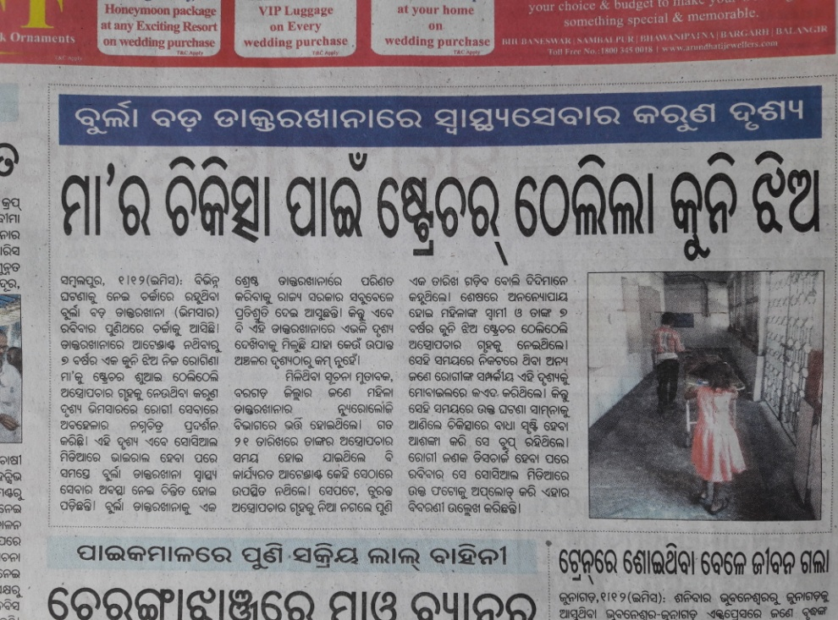
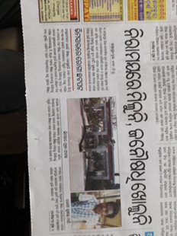
Poor quality of Human Development Indicators (Education, Health and Life Expectancy)
‘Big promises Poor delivery’
One can easily imagine the status of health services in the country. How can we dream of a Healthy Society? Similar is the fate of Education.

Slide 16
  Utilisation of resources
  Unbalanced Use of Resources
    Inefficient Utilisation
    Defective Selection of Priority Sector (Agriculture needs to be prioritised and augmented because it serves as the source of employment to the rural unskilled labour, who constitute a significant size of workforce)
    Unbalanced and inefficient utilisation of resources is due to the ‘Policy Bias’. This means the fiscal and monetary policies are biased and misguided and that too ‘short-term’ in nature.
    Policy Bias:
    Economic Reforms and Recent Monetary Reforms undertaken in a hurried and unplanned manner: Economic reforms in 1991 at the behest of World Bank and IMF. It is often designated as the ‘Fund-Bank Model’. Similarly Demonetisation was done in a hurry without regard to the possible consequences.
    - Economic reforms for a faster financial and infrastructural growth (Physical Capital)
    - Importance to large corporations to oil the rich
    - No strategic importance to the employment promoting sector, though, of course, now government has come up with new initiatives for the MSMEs. But, the policy aspect need to be understood properly.

Slide 17
Impacts of Policy Bias:
Declining Real GDP: Consequent upon such a biased policy often associated with populism, the real GDP is gradually declining. It is a surprise that the economic growth rate has come down to a six-year low of 4.5 percent in Q2 ending September 2019.
Informal Employment (partially due to elastic supply of unskilled labour in the LDCs). Example: Dadan
The consequence of the relatively very high importance to physical capital directly or obliquely means ‘Less Emphasis on Human Capital Building. Human capital is necessary to tap potential resources.
Inequality

Slide 18
Growth
Dwindling growth: Since 2014 India receding.
In 1991 it picked up, had a gradual increase over years
Atal Bihari Vajpayee – “India shining” slogan – Expansion of infrastructure
Growth unbalanced across regions and across sectors. Social sector given a boost but not to the benefit of common men. Industries flourished but without employment generation. All evils veiled the economy.
Loss of real strength to face the challenges
Now the institutional structure and the coercion pushes growth rate backward – what a shame it is! – Religious fundamentalism – Ram Janmabhumi; division of the country along religious lines.

Slide 19
Employment and Underemployment
Employment scenerio is hurrible.
Growing informality in the economy (emergence of informal sector) and within the formal sector. COVID-19 pandemic has unveiled the true magnitude of the phenomenon.
Informality leads to insecure employment and violation of labour laws
Informal employment not reflected in official statistics
Shortage of labour in labour surplus areas. Agriculture and MGNREGA gets affected.

Slide 20
Internal Decisions vis-à-vis External Impositions
Inequalities at the global level
Veto by countries (super powers)
Serve tea to US Prez (Attitude of being subservient)
Therefore, internal policies (strategic decisions) are affected. (GATT, WTO, Reforms)
Allowing FDI in Multi-brand Retail (Walmart and others)

Slide 21
  Global Consumerism: We have created an era of global consumerism without a proportionate increase in mass production. Imports are utilised to fill the deficiency in supply.

Slide 22
Parellel Economy
The growth of parallel economy is a matter of high concern.
Production activities carried underground
Informality in Employment (Growing informalisation is due to the black economy)
Insecure jobs
Squeezing the tax revenue

Slide 23
  Economic Burden
  Huge mass of unproductive consumers (0-14 and old-aged people) due to increasing gap between birth rate and death rate as well as due to increase in life expectancy.
  Educated Unemployed (Involuntary in nature)
Moral hazard: New Generation Earners (Labour?)
Moral hazard is observed when the attitude of people changes.
Owing to several inefficiencies in the society, there is a shift from engagement in productive to unproductive (anti-social) activities. Often many people are observed as not being interested to be absorbed in employment. This is mostly found in the illiterate environment. They prefer to earn without rendering labour, often as being engaged in illegal and anti-social activities.

Slide 24
Can we classify these activities under informal sector?
Alcoholic addiction among youth very often contributes to high crime rate (Gangsters and thieves) (Crime index for India 42.38; Pakistan 44.58, Afganistan 73.2)
Begging
Begging is an informal activity, termed illegal in some countries, e.g., Hungary has a nationwide ban.
In India, Bombay Prevention of Begging Act (BPBA), 1959 treats begging in Mumbai and Delhi as a criminal activity.
Begging under compulsion
Begging under will (The ‘Baba-culture’)

Slide 25
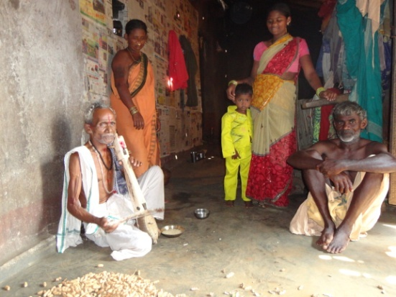
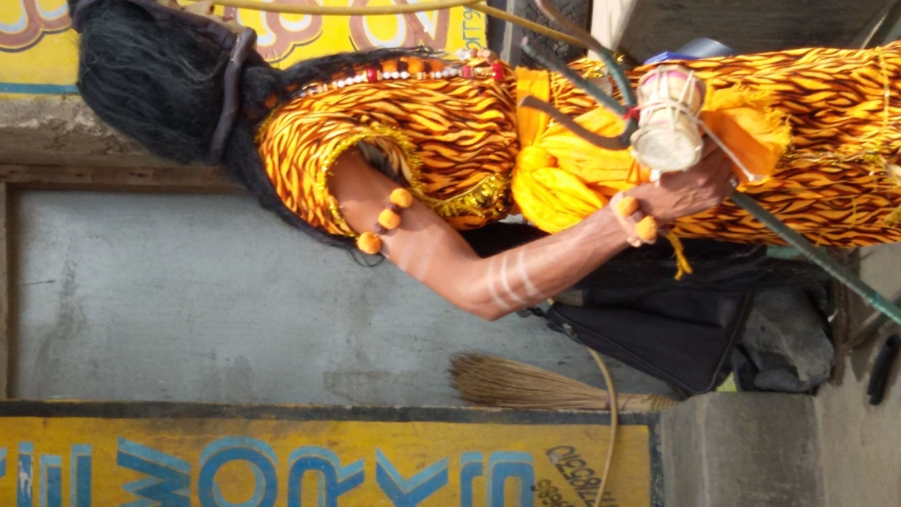
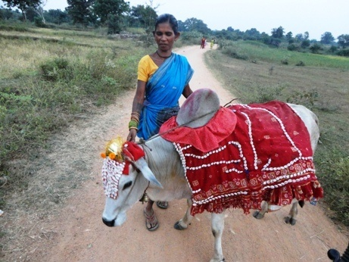
The ‘Baba-Culture’

Slide 26
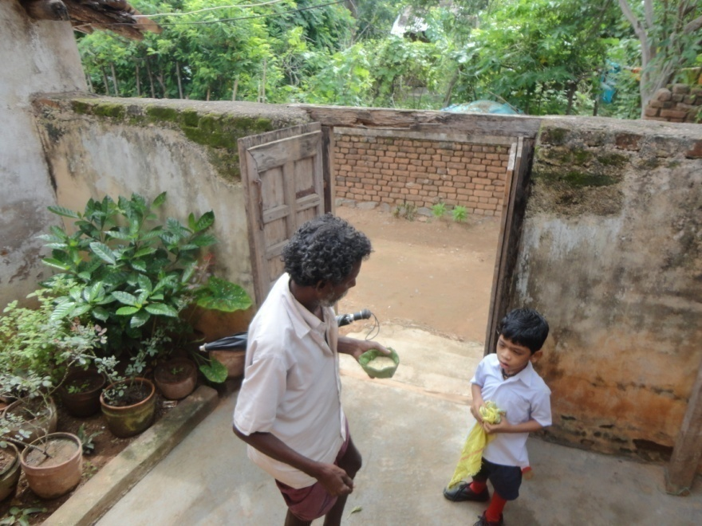
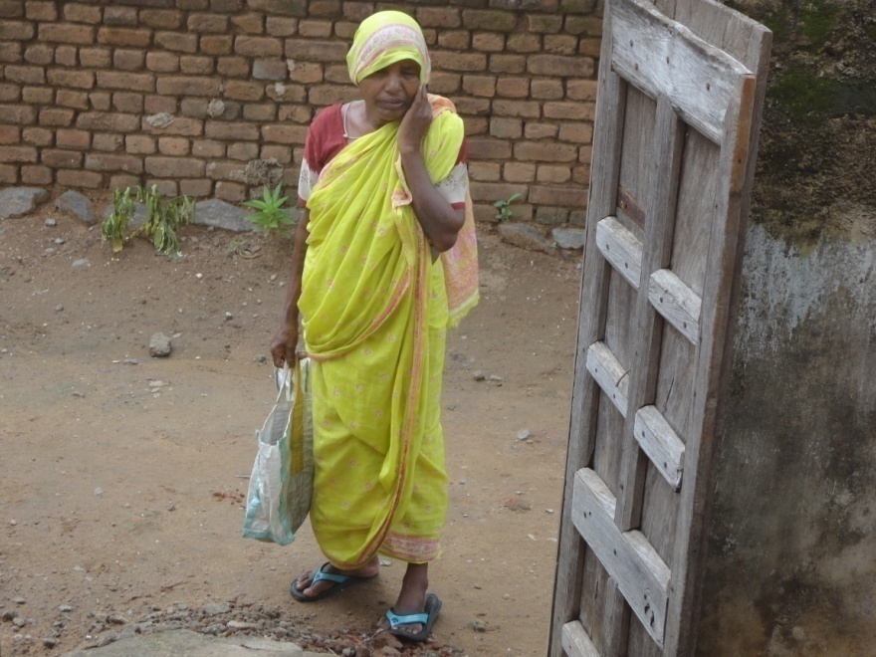
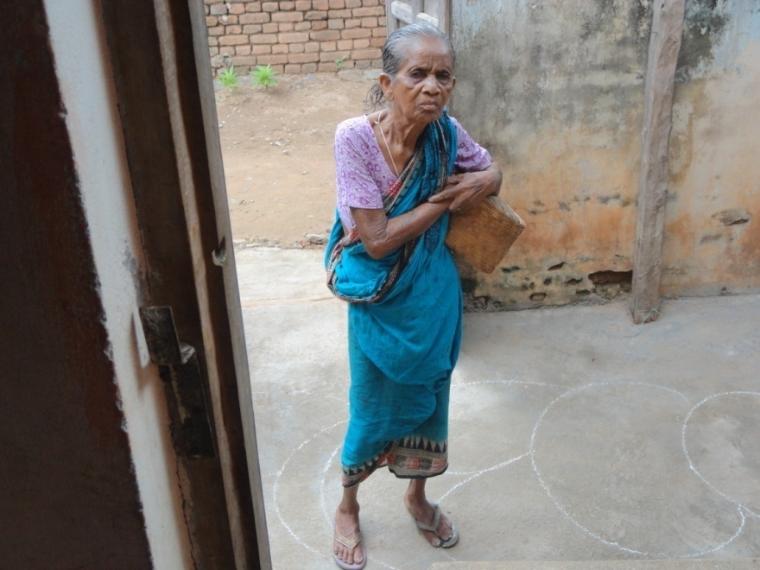
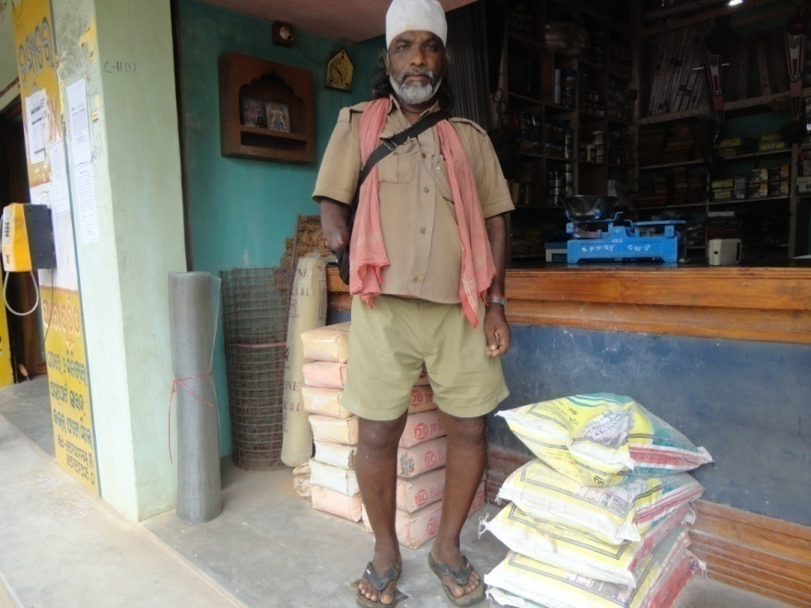

Slide 27
  Intervention
  (Employment generation/Poverty alleviation programmes/Food Security and Social Security)
  Meet failure due to several reasons.
  - Asymmetry of information: This leads to inefficiency in the selection of beneficiaries and to know the real problems.
  Fake beneficiaries (Kalia Yojana, Transfer payments, Subsidised Housing)
  -Moral Hazard: As a result, the programmes turn to be a misleading experimentation.
  -Employer and employee relations
  -During implementation of programmes proper monitoring is necessary

Slide 28
Recent Approaches to fight poverty by India
On 29 November 2019, the data on Q2 growth rate was released which reveals that the growth rate in Q2 slipped to a six-years low of 4.5 percent.
Suggesting cure to the economic crisis (depression deep rooted), Indian FM Nirmala Sitharaman said that government had responded well. Corporate tax had been reduced from 30 to 22 per cent. This suggests that the goal is to achieve corporate led growth. The welfare government is silent (willy-nilly accepts) over the inequality that has plagued the economy. This is another story of poverty - ‘Just avoid a potential solution to a big question.’ Recently the government have come up with series of measures to boost growth. It is yet to be seen whether the contribute to generation of domestic demand.
The most fundamental thing at this crucial juncture is to give emphasis on (i) education (ii) healthcare (iii) uplifting small and cottage sector. This was the model followed by the East Asian countries in the nineties, leading to ‘East Asian Miracle’- A miracle marked by flying geese pattern of growth.

Slide 29
Moral hazard economics: Sustainable Development
A Case in point: Niyamgiri-Vedant case hurts the cultural and religious sentiments of people. Pareto conditions and greatest happiness principle are violated.
5T measures by Government of Odisha (Let’s see how far 5Ts are effective!)
(The 5Ts aim at achieving progress through Transparency, Teamwork, Technology, Time and Transformation.)
Populist measures: ‘Sit and Eat’ policy – there is no need to go outside for income
- Doling out tonnes of foodgrains
- Unnecessary transfers (of tax-payers’ hard earned money)
* Kalia Yojana
Whereas countries attempt ban on begging our people are encouraging begging for alms from the government.

Slide 30
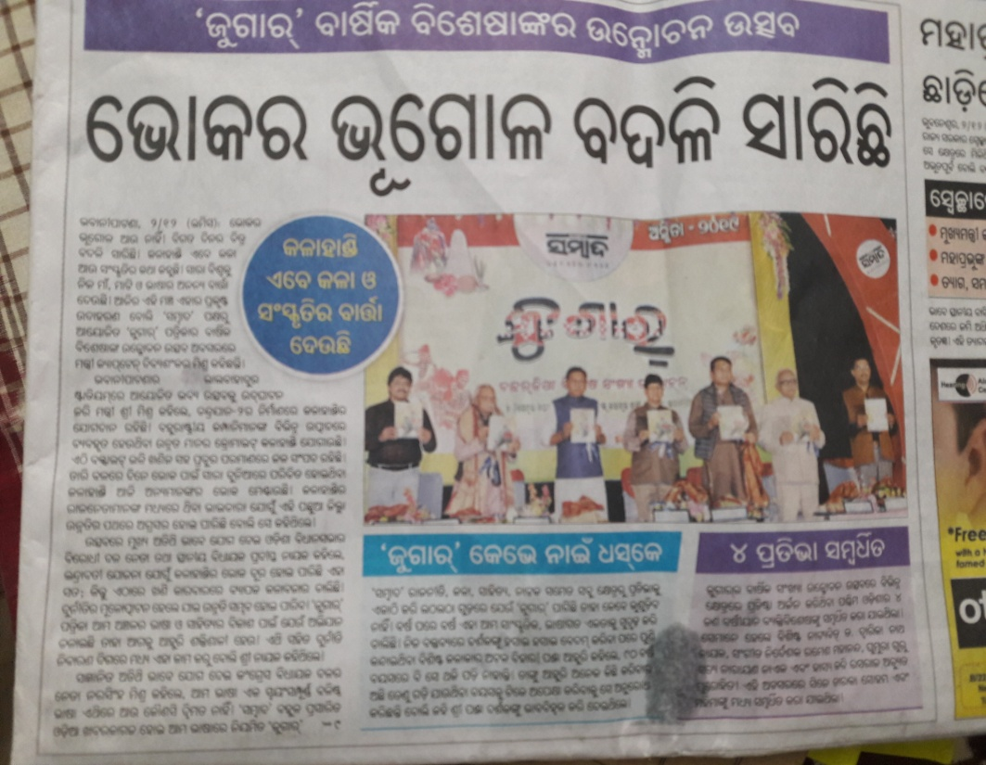
A legislature from Kalahandi district in Odisha lauds the influx of multinationals in to the
“Dark territory’ and treats it as ‘Achievement’. It is shameful to lament that the government machinery is trying to veil the ‘hunger’, which, perhaps is the only and perennial blessings that this region has ever been endowed with.

Slide 31
Recent Approaches

Slide 32
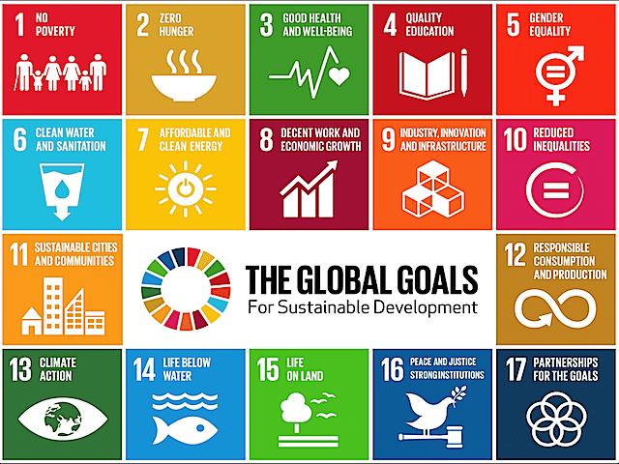

Slide 33
Suggestions
Understanding poverty in all its forms is essential. “A problem properly understood is half solved” – Victor Hugo.
Create Sustainable Livelihoods first (Merely doling out tonnes of food grains and pooling taxpayers’ hard earned money will not do!)
- Proper organisation and monitoring (MGNREGA and SHGs) See for example (Meher 2017).
Sustainable Development Goals (SDGs) is a broad step and in fact a struggle to root out poverty, corruption and other socio-economic evils.
Randomized Control Design (Banerjee, Duflo, Kramer) can work good but necessary safeguards to avoid problems arising out of asymmetric information, moral hazard, etc.

Slide 34
Suggestions (Contd..)
Externality is a consequence of the failure to assign property rights. Property rights create incentive to establish equilibrium. As long as someone owns a resource its price reflects the value for alternative uses and the resource is therefore used efficiently. In contrast, resources that are owned in common are abused because no one has incentive to economise their use.
Proper monitoring is necessary.
There is a need to change the mindset of the people for availing government provisions

Slide 35
  Conclusion
  The poverty of Indian Economy is evident from the recent growth rate figures, which, of course are a consequence of the policy decisions taken in a hurry. A situation of ‘vicious circle’ has been created from which we do not expect a panacea. We need a long term solution and should eye upon a long period of consistent effort. We should build up our indelible strength rather than decorating ourselves to showcase before others.
  Faulty and misguided policy leads to inefficient utilisation and hurried decision. This in turn leads to short term cure. This again leads to make the situation more disastrous than before and this way the circle continues.
  The indelible strength is our human resource, which, itself is also self-generating.
  Sustainable livelihood, therefore, should be the primary focus.

